Slide 1

WELCOME
Project details
INTRODUCTION
TO OUR PRESENTATION
LET’S SEE
Conclusion
Picture
Developed
Objective
Why this

Slide 2
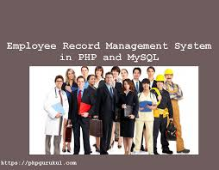
PROJECT NAME:
human resource management
GROUP MEMBERS:
MD. ASIF HUSSAIN (17DCS032)
MD. ATIF HUSSAIN (17DCS033)
MD. TASHHIRUL ISLAM (17DCS035)
Under the guidance of
Mr. MOHD ARIF
Picture
Objective
Developed
Why this
Introduction
Project details

Slide 3
Plan for Present our work…
Group Members
ATIF TASHHIRUL ASIF
(First present) (Second present) (Third present)
Present the PPT Show Running Understand database
& Project Implementation
Explain about Project & Language used & working of internal
Objective
Developed
Why this
Project details
Picture
INTRODUCTION

Slide 4
INTRODUCTION
(WHAT OUR PROJECT?)
The main aim of the Human Resource Management System software is to maintain all the sections of the organization easily. The application should be able to store, monitor, and access huge amount of data with better performance and which should be error free.
This paper deals with the process of identifying the employees, recording their attendance hourly and calculating their effective payable hours or days. This paper should maintain the records of each and every employee and their time spend in to company, which can be used for performance appraisal. Based on that transfer, removal, promotion can be done.
Objective
Developed
Why this
Project details
Picture
INTRODUCTION

Slide 5
INTRODUCTION
(WHAT OUR PROJECT?)
Human Resource Management System is a distributed application, developed to maintain the details of employees working in any organization. It maintains the information about the personal details of their employees, also the details about the payroll system which enable to generate the pay slip.
The main objective of this paper is to reduce the effort of Administrator to keep the daily events such as attendance, projects, works, appointments, etc. This paper should maintain the records of each and every employee and their time spend in to company, which can be used for performance appraisal.
Picture
Objective
INTRODUCTION
Developed
Project details

Slide 6
WHY WE CHOOSE THIS PROJECT??
The existing system is not providing secure registration and profile management of all the users properly. This manual system gives us very less security for saving data and some data may be lost due to mismanagement.
The paper is used to maintain efficiently the HR department schedule of any type of company. In larger organization, employees are large. At that time this paper is useful and helpful. HR Management system is not only becomes a desire of the company but it becomes the need of the company. The Administrator gets into the system using admin name and a password.
Developed
INTRODUCTION
Picture
Project details
Why this

Slide 7
WHY WE CHOOSE THIS PROJECT??
Limitations of Current System
Cost
Employee Privacy
Loss of Subjectivity
Difficult of Analysis
Proposed System and its Features
Fast retrieval of data
Security:
Payroll:
Work Time:
Administration:
Developed
INTRODUCTION
Picture
Project details
Why this

Slide 8
WHY WE CHOOSE THIS PROJECT??
Motivation
The Project is used to maintain efficiently the HR department schedule of any type of company. In larger organization, employees are large. At that time this paper is useful and helpful. As HRM play such an important role in creating a positive workplace culture and engaging in personnel development, gaining the right qualifications and professional accreditation is essential.
So, these things discussed with our supervisor Arif sir. So, From that I got motivated to make this project.
Contribution
In this project first we studies the drawback of existing system and what is the best possible way to handle large organization in computerized manner at this time. Then we have studies the different programming languages, by which we are able to develop a successful Human Resource Management System.
Developed
INTRODUCTION
Picture
Project details
Why this

Slide 9




Note: This is not all about. We are also discuss our problem altogether if occurs…
HOW WE DEVELOP OUR PROJECT:
First of all we divide the whole project into different parts among our group members as shown below:
PROJECT PLANNING
PLAN
PLAN
PLAN
PLAN
1
2
3
4
INTRODUCTION
Developed
Project details
Objective
Why this
follow
history
services
teams
Planning
timeline
about
PROJECT
MANAGEMENT
FRONTEND
&
DESIGNING
DATABASE
& CONNECTIVITY
BACKEND
&
TEST CASES
ASIF
ATIF
TASHHIRUL
ATIF
ASIF
TASHHIRUL

Slide 10
OBJECTIVE & PURPOSE OF THE SYSTEM
The main objective of this paper is to reduce the effort of administrator to keep the daily events such as payroll, employee performance, and employees’ details. It consists of six modules.
They are:
Employee Details
Payroll
Training
Performance
Resignation
Resume tracking.
Advantages
Easy access to the data
The new system is more user-friendly, reliable and flexible.
Data alteration is easy.
Maintenance of the project is easy.
Reduced manual work.
Timely Report generation.
Purpose
INTRODUCTION
Developed
Objective
Why this
Project details

Slide 11
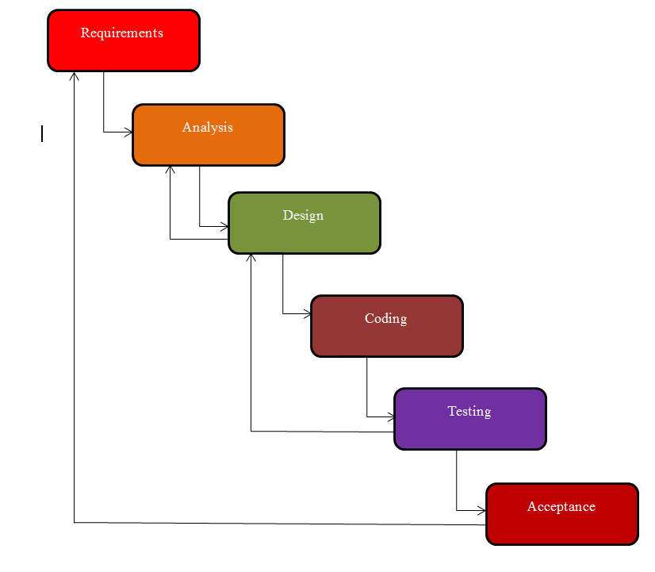
System Analysis and Design
Easy track is based on waterfall model of software engineering in “WATERFALL MODEL”, the process software development is divided into separate process phases. Software design, implementation, testing and maintenance. All these phases are cascaded to each other so that second phase is starts as and when defined set of goals are achieved for the first phase and it is signed off. So the name is suggested as "WATERFALLMODEL”. General view of a “WATERFALL MODEL” is given below:
Developed
INTRODUCTION
Objective
Waterfall Model
Why this
Project details

Slide 12
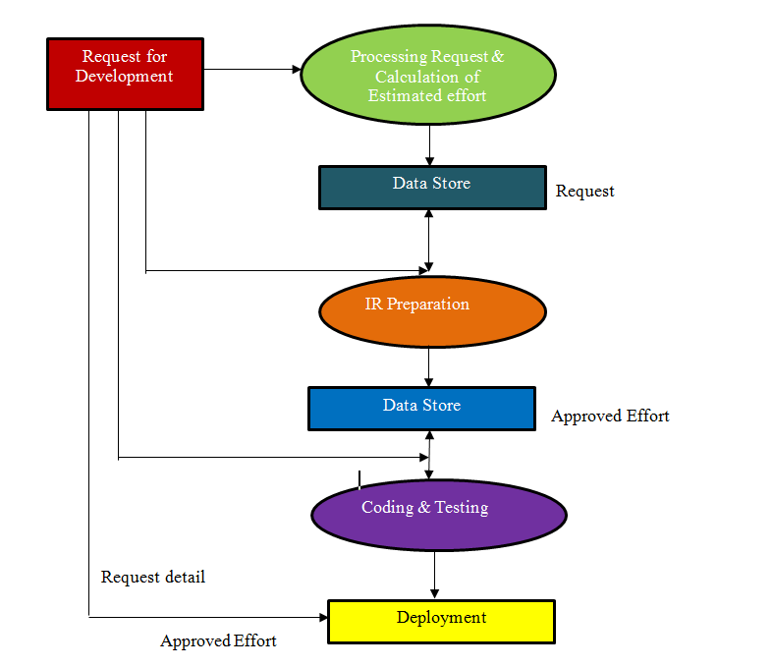
Logical Data Flow Diagram:
After studying the system the flow of data and process behind the system are shown in the following logical data flow diagram of the system:
Logical DFD
INTRODUCTION
Developed
Objective
Why this
Project details

Slide 13
Hardware & Software Specification for Client
Table 1: Hardware
Category Used
Computer PC-AT
Processor INTEL P4 & above
RAM 256 MB
Input Device Mouse or Keyboard
Output Device VDU (Minimum VGA, SVGA Support)
Table 2: Software
Category Used
Tools Dream weaver
Front End HTML, CSS, JAVASCRIPT,BOOTSTRAP,AJAX
Back End PHP
Database Used MySQL
Web Server Apache
Developed
INTRODUCTION
Objective
System Requirement
Why this
Project details

Slide 14
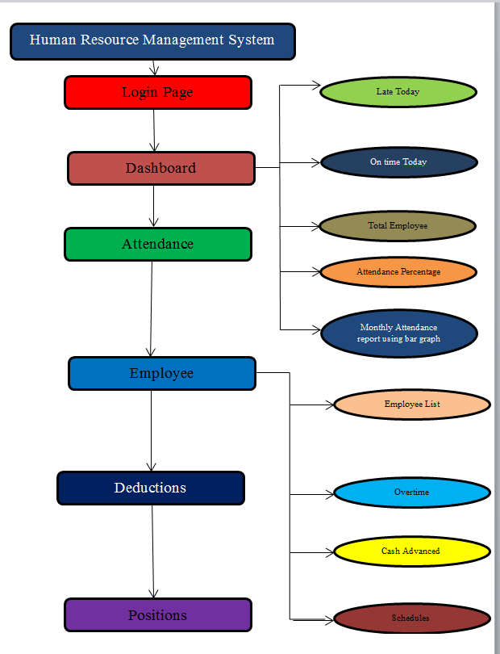
System Hierarchy
Developed
INTRODUCTION
Objective
System Hierarchy
Why this
Project details

Slide 15
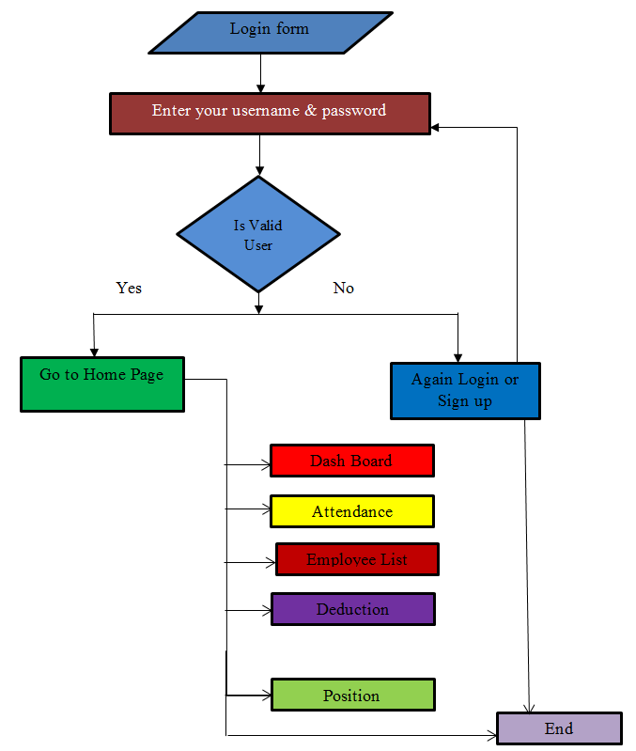
System Flow Chart
System flow chart is graphical representation of the system showing the overall flow of control in processing. It specifies what activities must be done to convert from physical to logical model.
Developed
INTRODUCTION
Objective
System Flow Chart
Why this
Project details

Slide 16
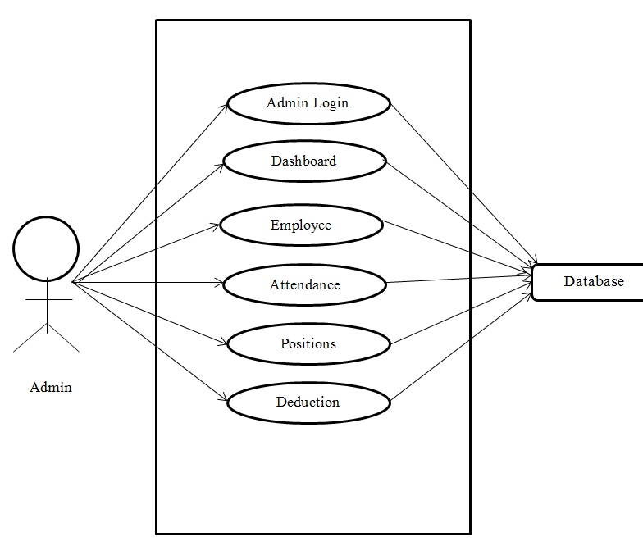
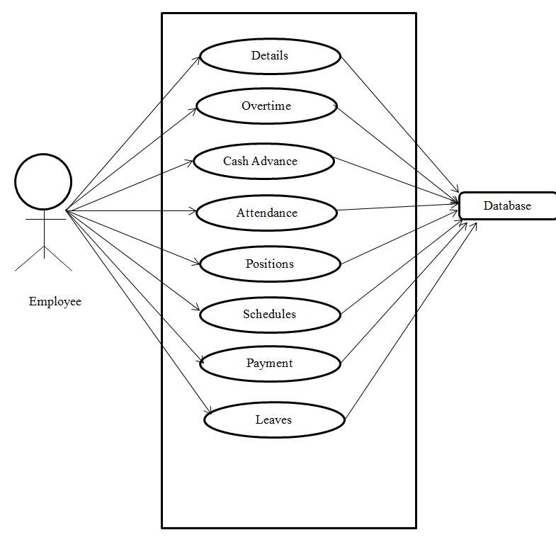
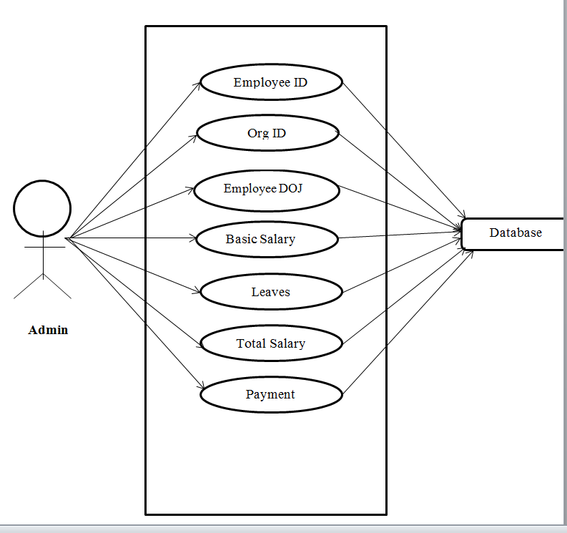
Use Case Diagram
A use case diagram at its simplest ia a representation of a user’s interaction with the system that shows the relationship between the user and the different use cases in which the user is involved.
Developed
INTRODUCTION
Objective
Use Case Diagram
Why this
Project details

Slide 17
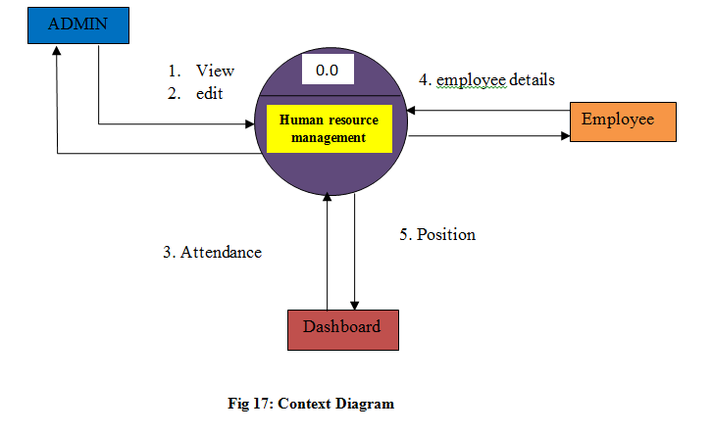
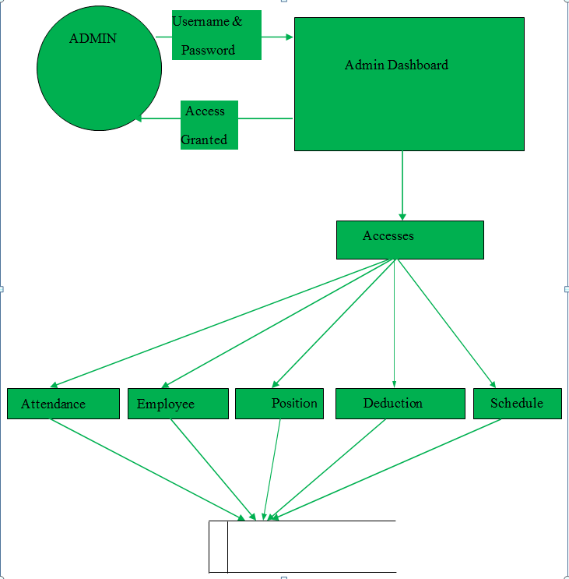
Data Flow Diagram
Data Flow Diagram is the logical representation of the data flow of the project. It is drawn by using different symbols. A reader can get the exact idea of the project by seeing the data flow diagram.
DFD
INTRODUCTION
Developed
Objective
Why this
Project details

Slide 18
MODULES & THEIR DESCRIPTION
Employees Details
Payroll
6
1
HRM
Modules
INTRODUCTION
Developed
Objective
Performance
Positions
Why this
Project details
5
2
Deductions
4
3
Schedule

Slide 19
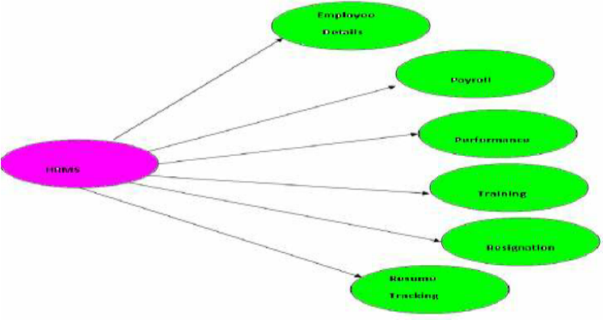
Overview of Human Resource Management Systems
N
Overview of Human Resource Management Systems
Admin
Login – This module is used for admin login.
Dashboard – Admin dashboard related total employee details.
Late today
On time today
Total Employee
Attendance percentage
Monthly attendance report using bar graph
Attendance – It shows the total attendance of employee.
Employee – This shows total employee details.
Employee List
Overtime
Cash Advanced
Schedules
Positions – It shows the position of employee.
Payroll – It calculate the total salary
Deductions – It reduce the salary.
Objective
services
Introduction
services
Why this
Project Details

Slide 20
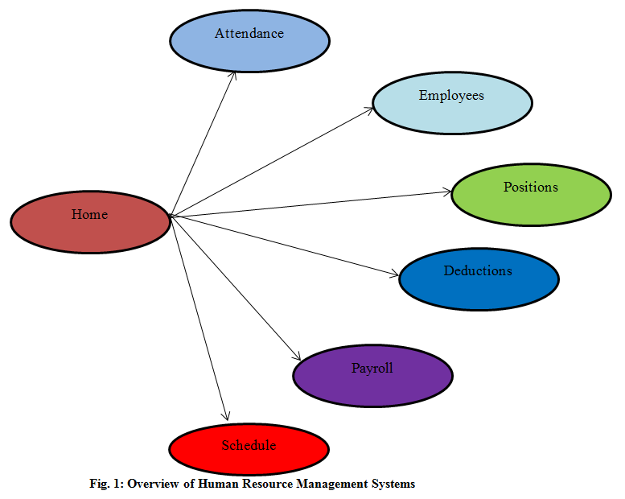
Overview of Human Resource Management Systems
N
Overview of Human Resource Management Systems
User
User Id – User through this panel
Time-in – Time will be noted when user enters.
Time-out – Time will be noted when user exit.
Schedules – It shows the employee working time.
Objective
services
Introduction
Implementation
Why this
Project Details

Slide 21
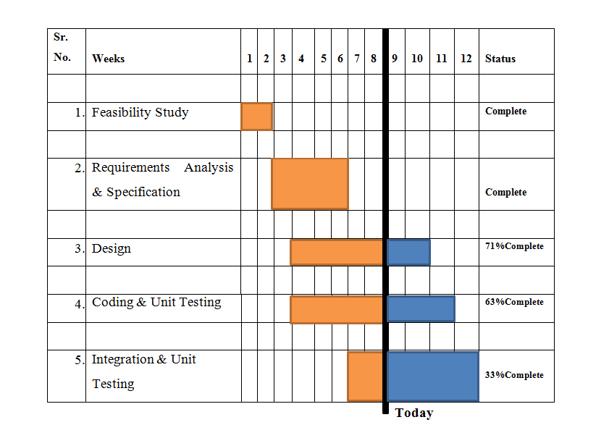
Overview of Human Resource Management Systems
N
Overview of Human Resource Management Systems
Gantt Chart
A Gantt chart is a type of bar chart that illustrates a project schedule. Gantt charts illustrate the start and finish dates of the terminal elements and summary elements of a project. Terminal elements and summary elements comprise the work breakdown structure of the project. Some Gantt charts also show the dependency (i.e. precedence network) relationships between activities. Gantt charts can be used to show current schedule status using percent-complete shadings and a vertical "TODAY" line as shown here.
services
Introduction
Gantt Chart
Objective
Why this
Project Details

Slide 22
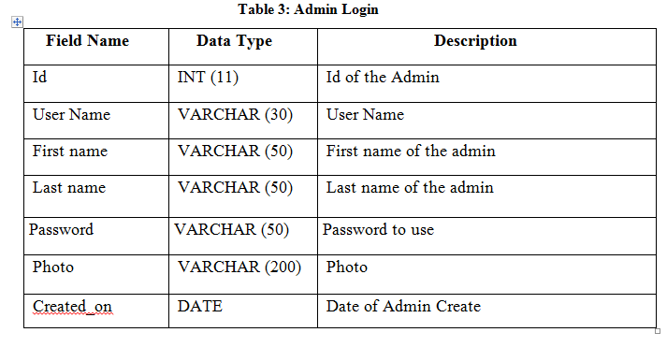
Overview of Human Resource Management Systems
N
Overview of Human Resource Management Systems
Database Design
The data in the system must be stored and retrieved from database. Designing the database is part of system design. Data elements and data structures to be stored have been identified at analysis stage. They are structured and put together to design the data storage and retrieval system.
services
Introduction
Database
Objective
Why this
Project Details

Slide 23
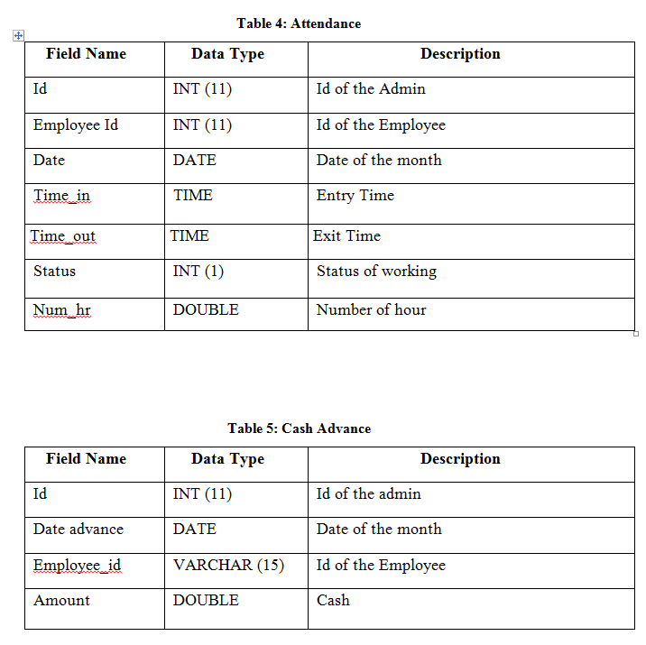
Overview of Human Resource Management Systems
N
Overview of Human Resource Management Systems
services
Introduction
Database
Objective
Why this
Project Details

Slide 24
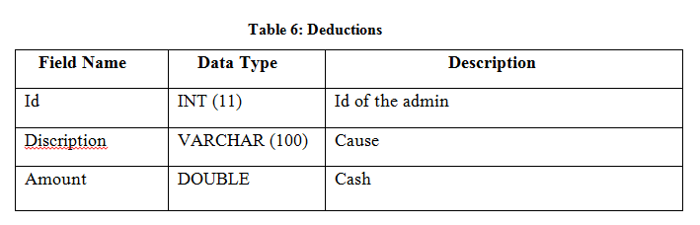
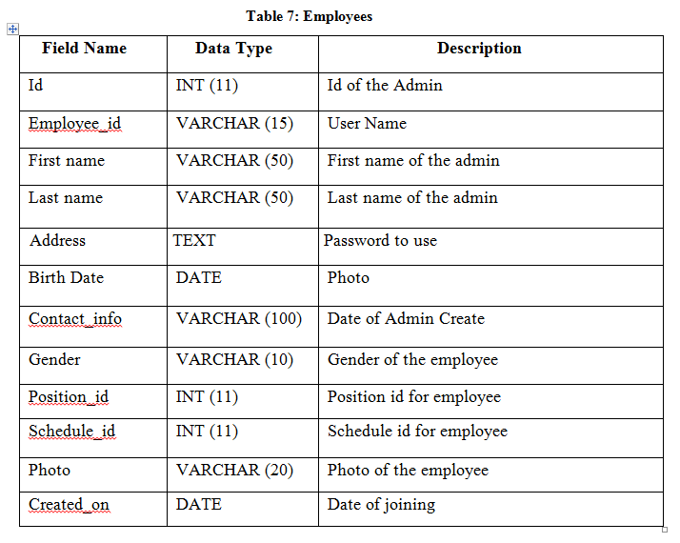
Overview of Human Resource Management Systems
N
Overview of Human Resource Management Systems
Objective
services
Introduction
Database
Why this
Project Details

Slide 25
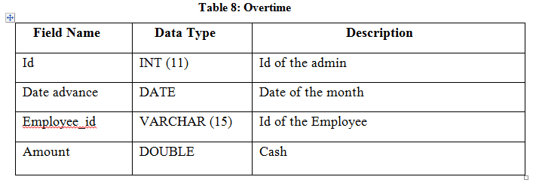
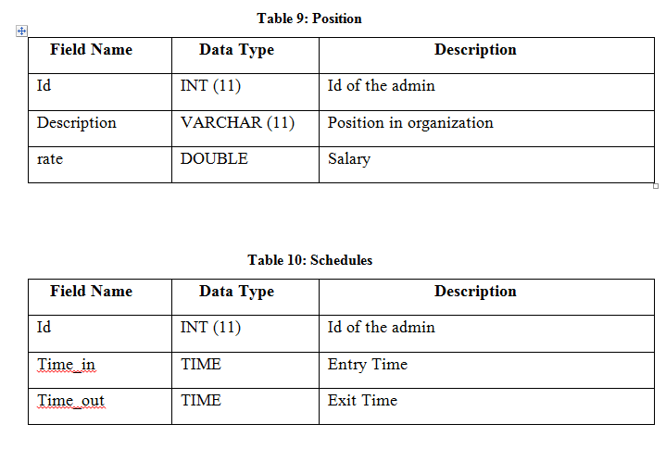
Overview of Human Resource Management Systems
N
Overview of Human Resource Management Systems
Objective
services
Introduction
Database
Why this
Project Details

Slide 26
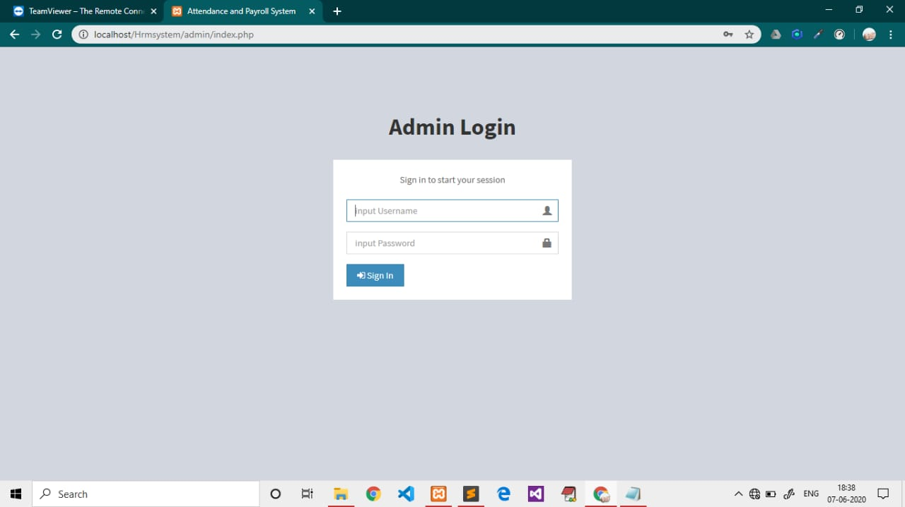
Overview of Human Resource Management Systems
N
Overview of Human Resource Management Systems
Some looks of our projects:
Admin Login
INTRODUCTION
Project details
Objective
services
Login Page
Why this

Slide 27
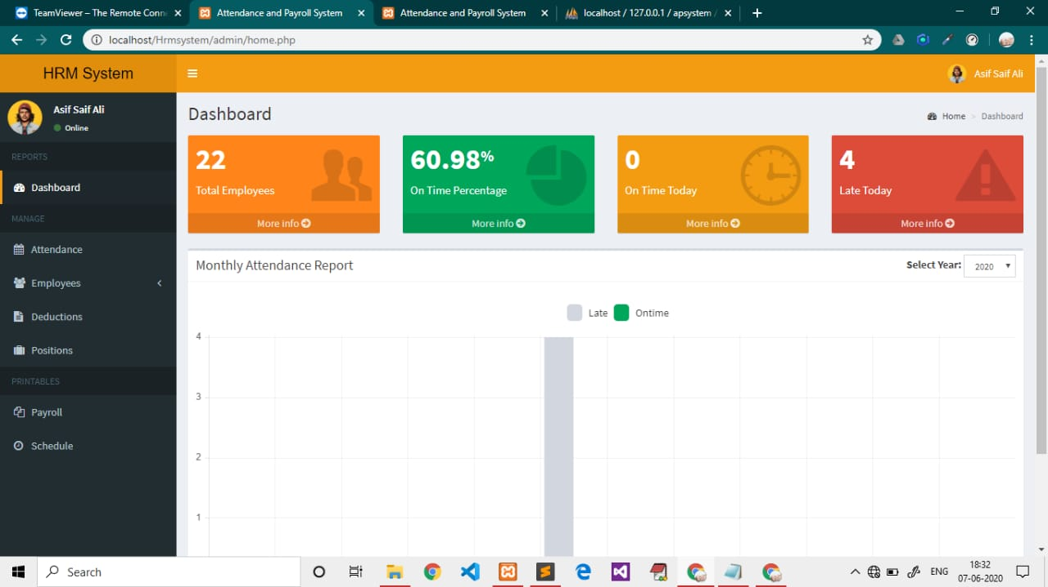
Overview of Human Resource Management Systems
N
Overview of Human Resource Management Systems
Some looks of our projects:
Dashboard chart of employees:
Project details
Developed
INTRODUCTION
Objective
Why this
services

Slide 28
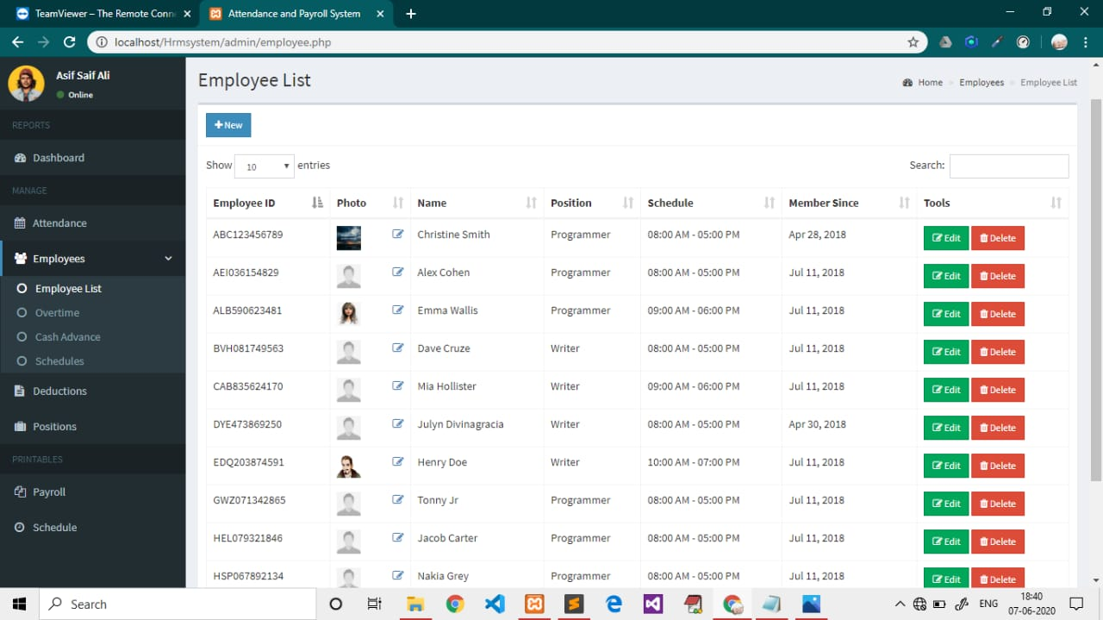
Overview of Human Resource Management Systems
N
Overview of Human Resource Management Systems
Some looks of our projects:
Employees List:
Project details
Objective
INTRODUCTION
services
services
Why this

Slide 29
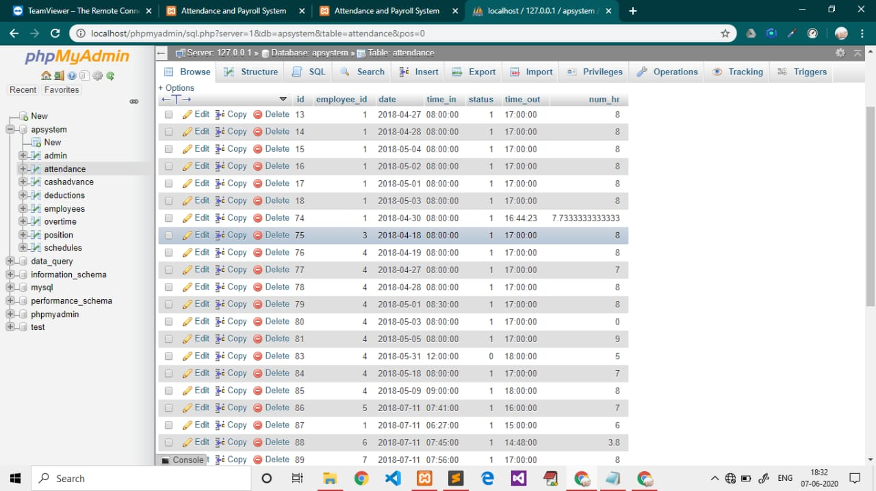
Overview of Human Resource Management Systems
N
Overview of Human Resource Management Systems
Some looks of our projects:
Database:
Why this
Project details
Objective
services
Introduction
Database

Slide 30
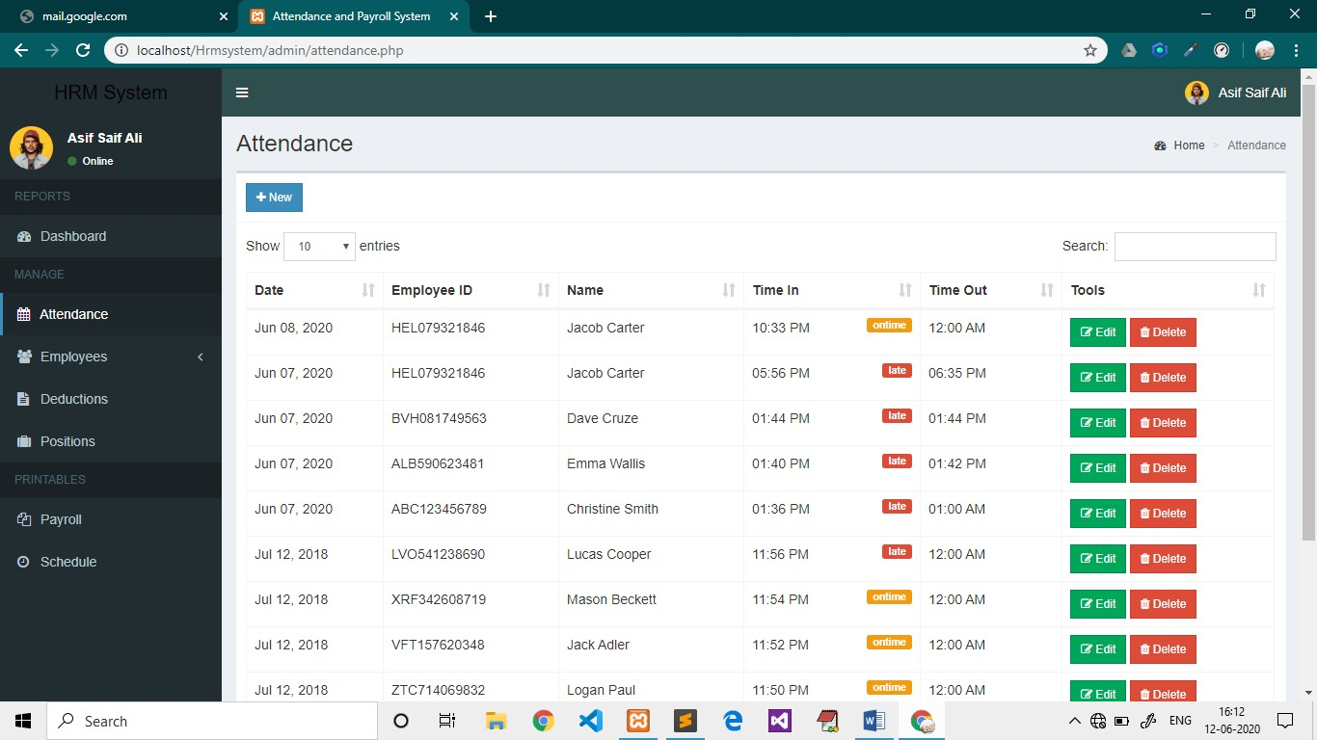
Overview of Human Resource Management Systems
N
Overview of Human Resource Management Systems
Some looks of our projects:
Attendance:
Why this
Project details
Objective
services
Introduction
Services

Slide 31
Overview of Human Resource Management Systems
N
Overview of Human Resource Management Systems
Conclusion:
In conclusion I would like to tell that this Human Resource Management Systems has achieved its purpose. It has taken a huge task for this project to be completed. It has given a huge lift to the company’s operations. What ever that has done manually has been completely shifted to the computerized process and this has enabled the company to carry out its operation more quickly. This has also given a wider spectrum of communication to the users. Since whatever that has so far been done manually has been changed to a computerized. It has resulted in more efficient processing of data.
The new system has resulted in giving numeric advantages to the company in many ways. Some of
them are given below State of negligible paper work is almost reduced. Accessing and getting data can be done at a single click. Data manipulation has become simpler and the cost factor has been reduced. It is faster and more efficient processing of data. It is less time consuming. Operations are more transparency. Communications between the users is more efficient.
Future Work:
Objective
Why this
Project details
INTRODUCTION
services
Conclusion
The last decade brought an avalanche of change to the HR industry and HR software in particular. The rise of artificial intelligence. The growth of the gig economy. The increased push towards greater diversity. And many other headline disruptors. As we turn the page into 2020 and a new decade, it’s only appropriate to look ahead for a glimpse of which HR trends will continue to drive transformation and which new trends will emerge to shape the future of work.

Slide 32


Overview of Human Resource Management Systems
N
Overview of Human Resource Management Systems
My sincere and gratitude thanks to our projects supervisor Arif sir for his guidance. Without his motivational wording we would not be able to set off. His guidance gave me a lot of confidence in now a pandemic COVID-19 days.
THANK YOU
We extend our thanks to other faculty members and non-teaching staff of University Polytechnic for providing all kind of support.
services
services
teams
history
timeline
about

